Slide 1

Sprocket Central Pty Ltd
Data analytics approach
[Internship Division] - [KPMG Engagement Manager], [KPMG Senior Consultant],
[KPMGJunior Consultant]
Presented By - Ameya Bhivgade

Slide 2
Agenda
Introduction
Data Exploration
Model Development
Interpretation

Slide 3
Introduction
Customer Data Analysis :
Age Distributions.
Number of Bike Purchases in Last 3 Years.(In Percentages)
Job Industries Category.
Wealth segments.
Number of Cars own by each States.

Slide 4
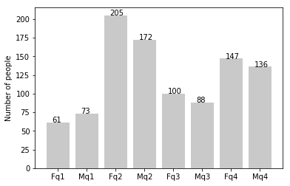
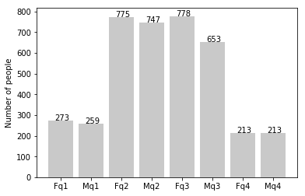
Data Exploration
NEW
Customers
Customer Age Distributions :
New Customers are in between 25 to 48 age category.
Age group from 48 to 59 has big drop on percentages.
Slightly increment in customer over age of 59.
Customers under 25 Age category never changes.
Old
Customers

Slide 5
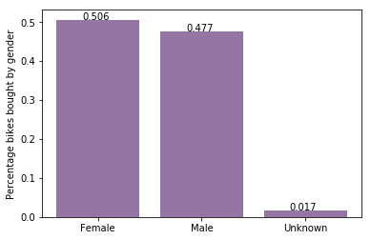
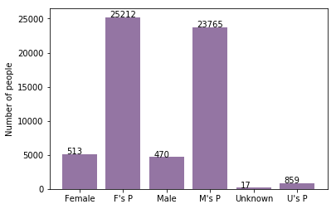
Model Development
Bike purchases last 3 years
As we can see, our new customers mostly Female with 50.6% purchases with total of 25,212 bikes
Male contributed to 47.7% purchases with 23,765 bikes
So we should focus on advertises on Female customers than Male customers

Slide 6
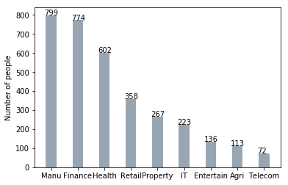
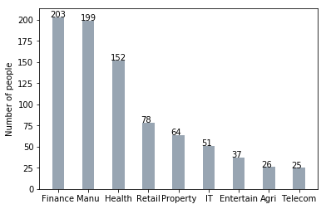
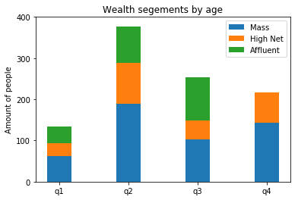
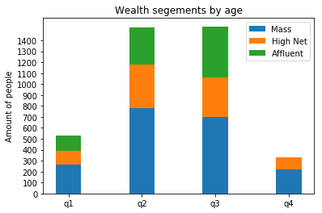
Interpretation
Job industry category
Mostly our new customers are on Finance industry and our Manufacturing customers are still on top 2.
The rest industries is still same
Wealth segments
In all ages, the number of Mass Customers is the highest so we should focus on this social class.
After that, we should focus on High Net Customer.
Then Affluent Customers but mostly second and third quadrant

Slide 7
Interpretation
Numbers of cars owned
NSW should be considered the most since numbers of customers don’t own cars is significantly larger than that own.
VIC and QLD has more customers that own car that who don’t but we can try to have something so that those owns car will buy bikes.

Slide 8
Note: The data and information in this document is reflective of a hypothetical situation and client. This document is to be used for KPMG Virtual Internship purposes only.
Appendix

Slide 9
Note: The data and information in this document is reflective of a hypothetical situation and client. This document is to be used for KPMG Virtual Internship purposes only.
Appendix
All supporting items in that attachment.

